Slide 1
LIMU-BERT: Unleashing the Potential of Unlabeled Data for IMU Sensing Applications
Huatao Xu, Pengfei Zhou, Rui Tan, Mo Li¹
Guobin Shen²
(¹Nanyang Technological University-Singapore, ²Alibaba Group)
Presenter: Shovito Barua Soumma
Date: September 11, 2024
Archive SenSys 2021, [74 Citations as today]
Code Base: https://github.com/dapowan/LIMU-BERT-Public
Notes:
Presenter: Shovito Barua Soumma

Slide 2
Introduction
Self-Supervised Learning for IMU Data: LIMU-BERT adapts BERT’s self-supervised approach to learn general representations from IMU sensor data. This reduces the need for extensive labeled datasets and allows task-specific models to be trained with limited labeled samples.
IMU Data-Specific Adaptations: makes BERT design suitable for IMU data, such as multi-sensor data fusion, customized normalization, and lightweight model architecture to accommodate the constraints of mobile devices.
Performance Gains: The model is evaluated across four open datasets, demonstrating significant improvements in HAR and DPC (device placement classification) tasks compared to state-of-the-art models, achieving over 10% higher accuracy and F1-scores.
The results highlight that LIMU-BERT significantly outperforms existing models such as DCNN, DeepSense, and TPN, particularly when the labeling rate is low. The model’s performance remains robust across varied IMU sequence lengths, sensor combinations, and normalization techniques.
Lightweight and Efficient Design: LIMU-BERT is designed to be computationally efficient, making it deployable on mobile devices while maintaining strong performance.
BERT has 110m parameters => too heavy for mobile devices
Notes:
Device Placement Classification (DPC) is the task of determining where a device is located or positioned on a user's body based on data from Inertial Measurement Unit (IMU) sensors such as accelerometers, gyroscopes, and magnetometers. For example, in wearable sensing applications, DPC can classify whether a smartphone is placed in a pocket, on a belt, on a wrist, or carried in a bag.

Slide 3
Method
The model uses a self-supervised training phase followed by supervised fine-tuning. During self-supervised training, LIMU-BERT predicts masked parts of the IMU sequences, learning both distributional and temporal features. The lightweight architecture and parameter sharing techniques enable the model to run efficiently on mobile devices.
Notes:
1. Distributional Features:
Distributional features capture the statistical properties of the sensor readings, such as their range, variance, and how the values are distributed. These features are crucial because different activities or device placements lead to different distributions of sensor data.
Example: Consider accelerometer readings when a person is standing still versus walking. When standing, the readings are more stable and have a narrow range, whereas when walking, the readings have a broader range due to the movement. The distribution of values (how frequently certain ranges of values appear) is a key distinguishing feature.
Importance: Capturing the distribution of IMU data allows the model to understand patterns related to different activities, even if the activity or placement is not directly observed.
2. Temporal Features:
Temporal features relate to the time-dependent relationships between sensor readings. These features capture the patterns, trends, and sequences in the data over time, which are essential for understanding dynamic activities.
Example: When a person is running, the accelerometer and gyroscope readings show periodic peaks and valleys due to repetitive motion (like steps). The timing, frequency, and regularity of these changes are temporal features that can distinguish running from walking or standing still.
Importance: Temporal features allow models to understand how data evolves over time, which is critical for recognizing patterns in continuous activities (like walking, running, or transitions between states).
he parameter sharing technique refers to a method used in deep learning models where the same set of parameters (weights) is reused across different layers or components of the model. ften applied to reduce the number of parameters, making the model more efficient

Slide 4
Intro: representation learning
BERT
2 SSL pretext tasks
Masked Langua Model
Next Sentence Prediction: 2 given sentences are subsequent or not

Slide 5
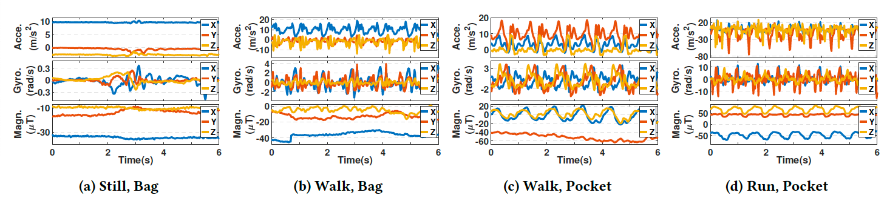
Uniqueness of IMU
Fig 1a: Gyroscope is more sensitive to the movement compared to acc and mag
Fusion matters (acc + gyro + mag)
Distribution & Context Matters
Statistical features for different positions/activities are not the same
Walk: Gyro => (-5,5) (Fig. 1b, 1c)
Running: Gyro => (-15,+15) (Fig. 1d)
Acc-Y readings depends on device location (bag vs pocket)

Slide 6
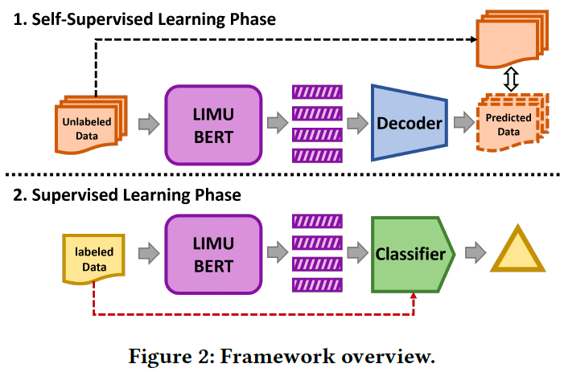
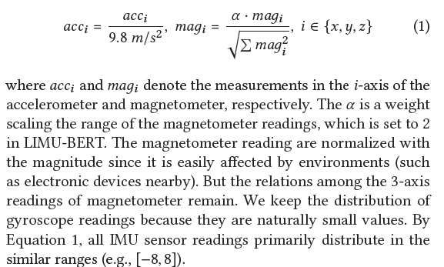

Design
Pretext: Masked input signal
Fusion & Normalization

Slide 7
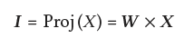
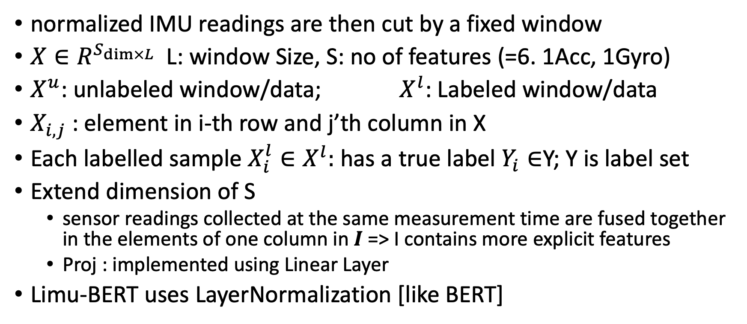
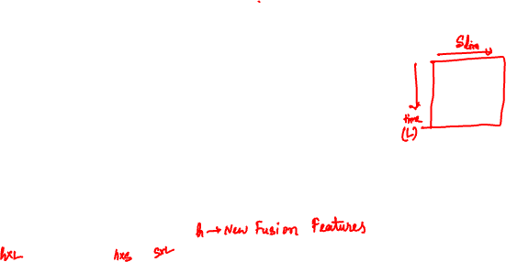
Problem Formulation
normalized IMU readings are then cut by a fixed window
$X∈R^{S_{\dim{×L}}}$L: window Size, S: no of features (=6. 1Acc, 1Gyro)
$X^{u}$: unlabeled window/data; $X^{l}$: Labeled window/data
$X_{i,j}$: element in i-th row and j’th column in X
Each labelled sample $X_{i}^{l}∈X^{l}:$ has a true label $Y_{i}∈$Y; Y is label set
Extend dimension of S
sensor readings collected at the same measurement time are fused together in the elements of one column in 𝑰 => I contains more explicit features
Proj : implemented using Linear Layer
Limu-BERT uses LayerNormalization [like BERT]

Slide 8
Span Masking
MLM works better then NSP as a pre-task in IMU dataset
Can’t mask a single point, mask length must be>1
IMU sensor data are collected over time, and adjacent data points are often similar. If only individual readings are masked, the model might just "mirror" the nearby readings without learning meaningful relationships

Slide 9
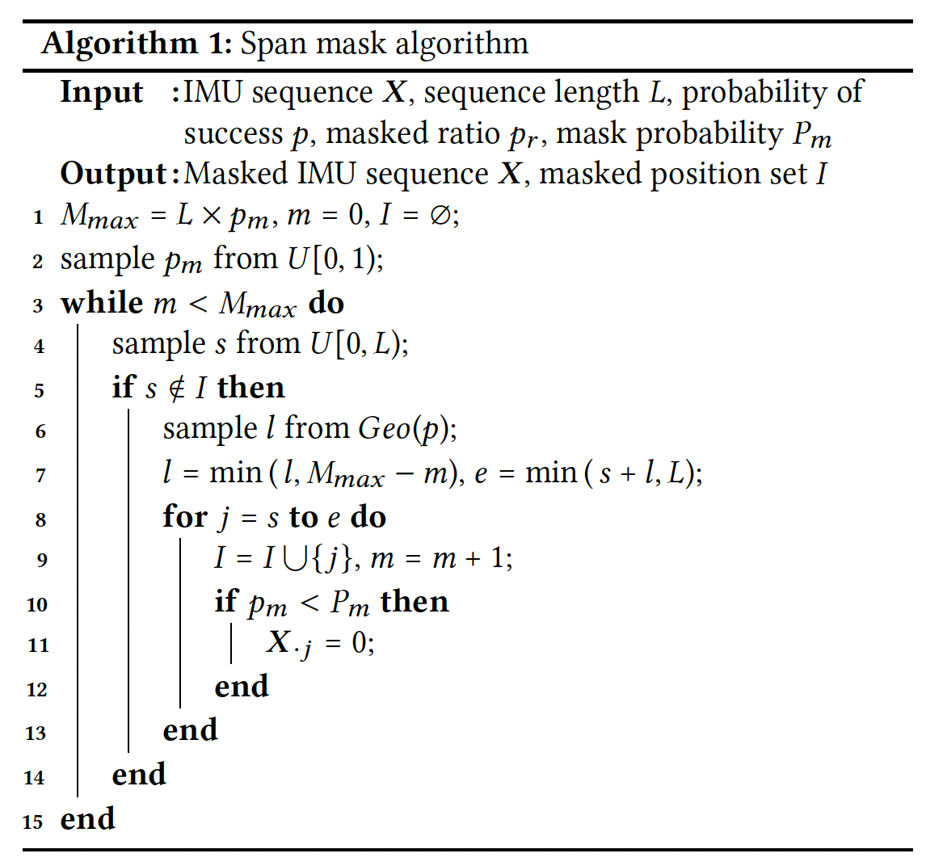



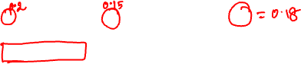
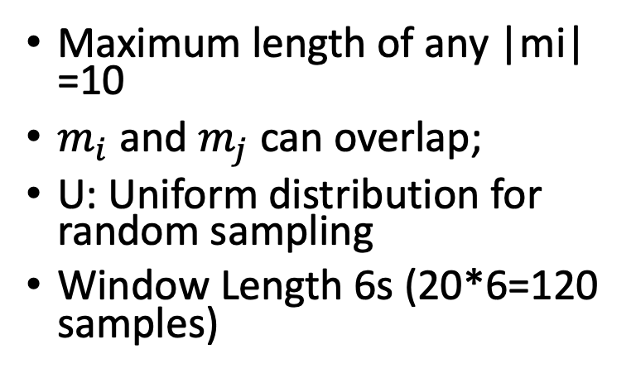
Span Masking
Maximum length of any |mi| =10
$m_{i}$ and $m_{j}$ can overlap;
U: Uniform distribution for random sampling
Window Length 6s (20*6=120 samples)

Slide 10
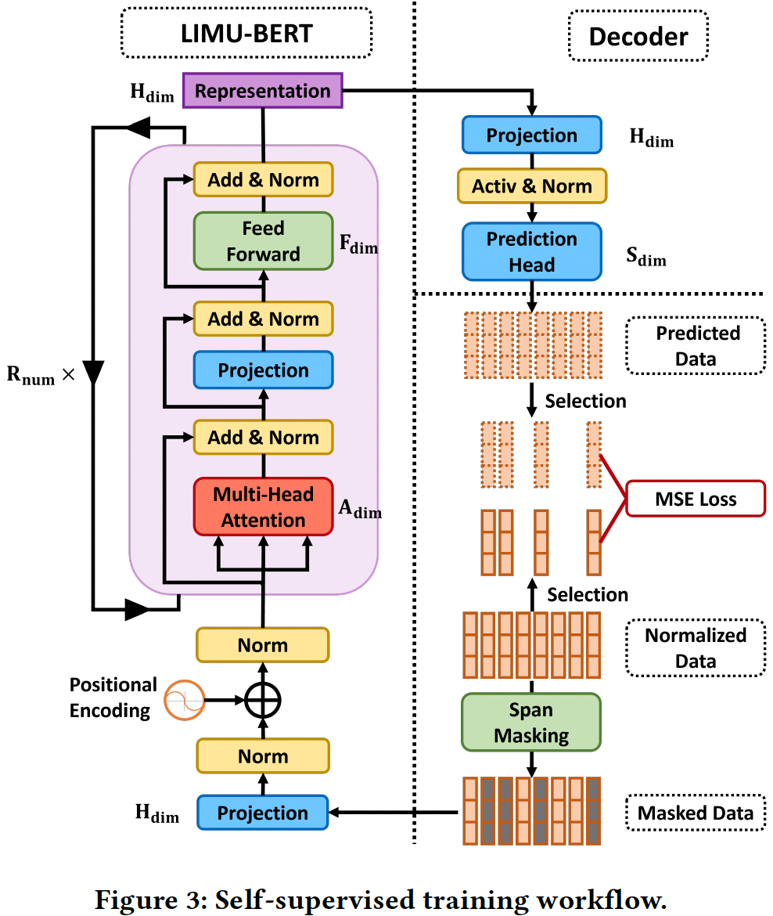
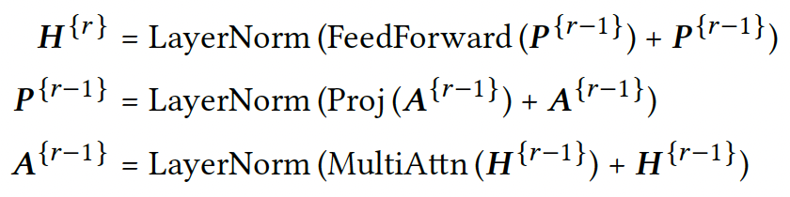
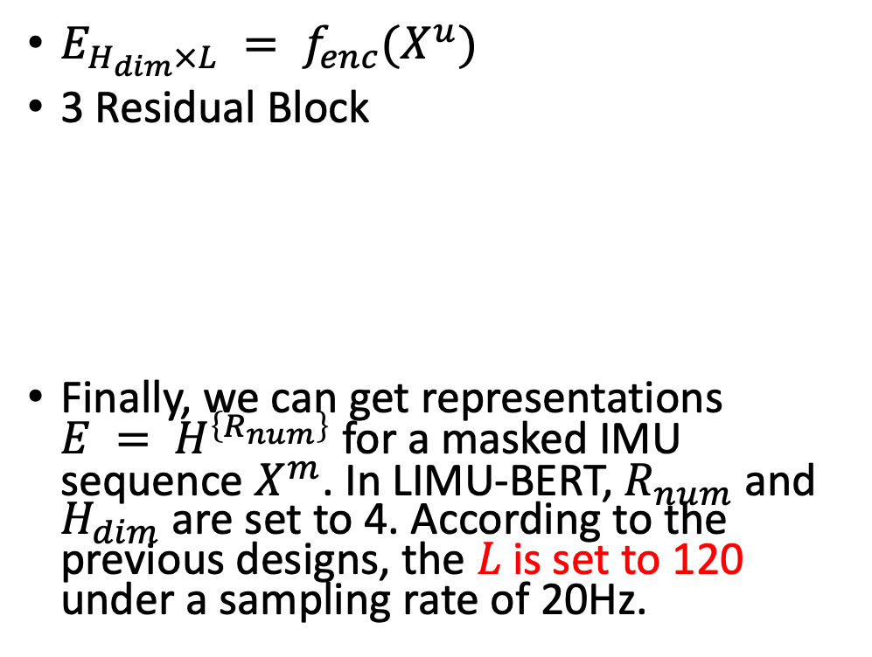
SSL workflow
$E_{H_{dim}×L} = f_{enc}(X^{u})$
3 Residual Block
Finally, we can get representations $E = H^{\left\{R_{num}\right\}}$ for a masked IMU sequence $X^{m}$. In LIMU-BERT, $R_{num}$ and $H_{dim}$ are set to 4. According to the previous designs, the 𝐿 is set to 120 under a sampling rate of 20Hz.
R=1 trainable; if R≠1 then shared the parameters of R=1
Notes:
First, given the sampling rate of IMU sensors, the number of readings collected in six seconds is large. For example, the sequence
length 𝐿 is 600 if the sampling rate is 100 Hz, which is larger than the maximum sequence length (i.e., 512) in the original BERT

Slide 11
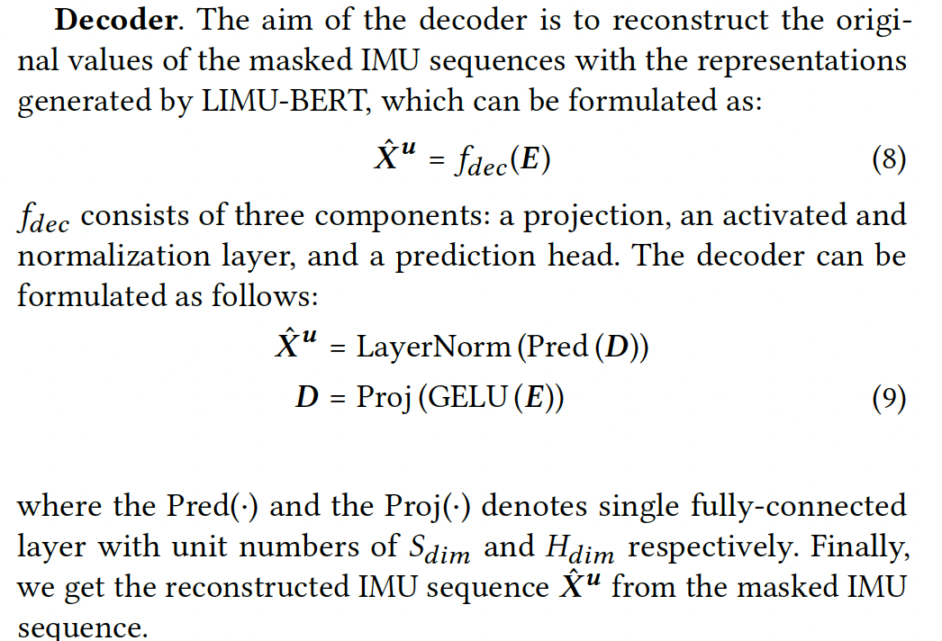
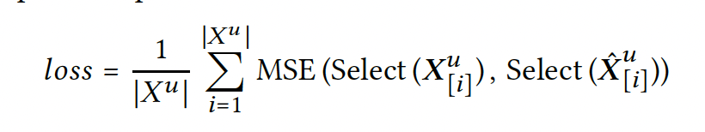


SSL workflow

Slide 12
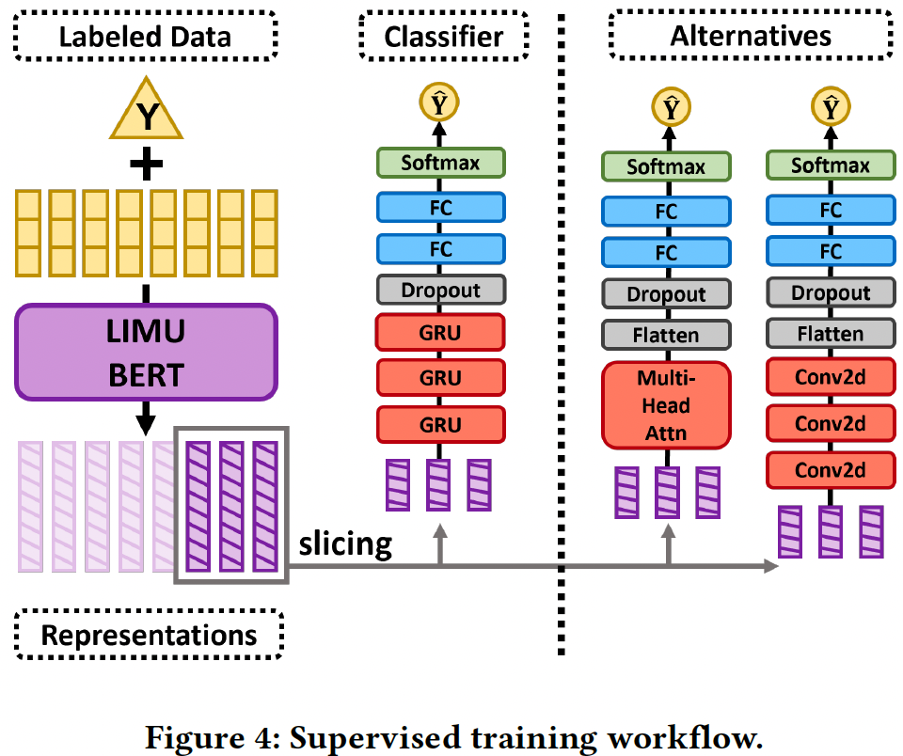
Supervised workflow
Dropout to reduce overfitting
GRU is lightweight => faster
Train (80%)
1% for labelled
99% unlabelled
Test : 10%
Validation: 10%
Used to select the classifier model for the downstream
Normalized

Slide 13
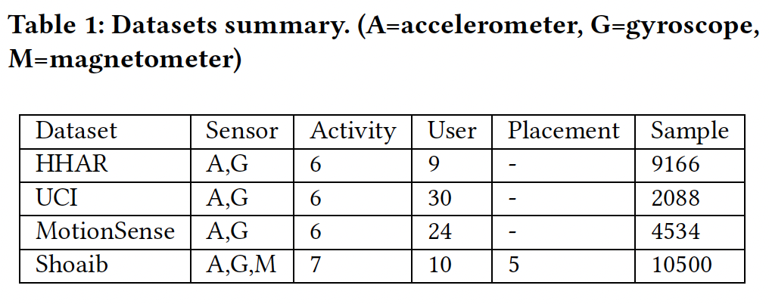
Results
Different datasets
Different sensor combination
Different label ratio
Different window size/seq. length
Different classifiers in the downstream task
DPC - Device Position Classification (SHOAIB dataset)

Slide 14
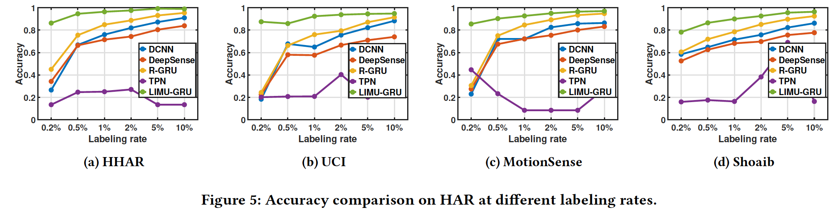
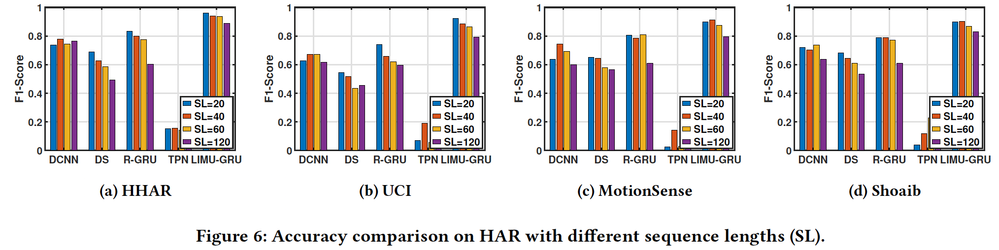
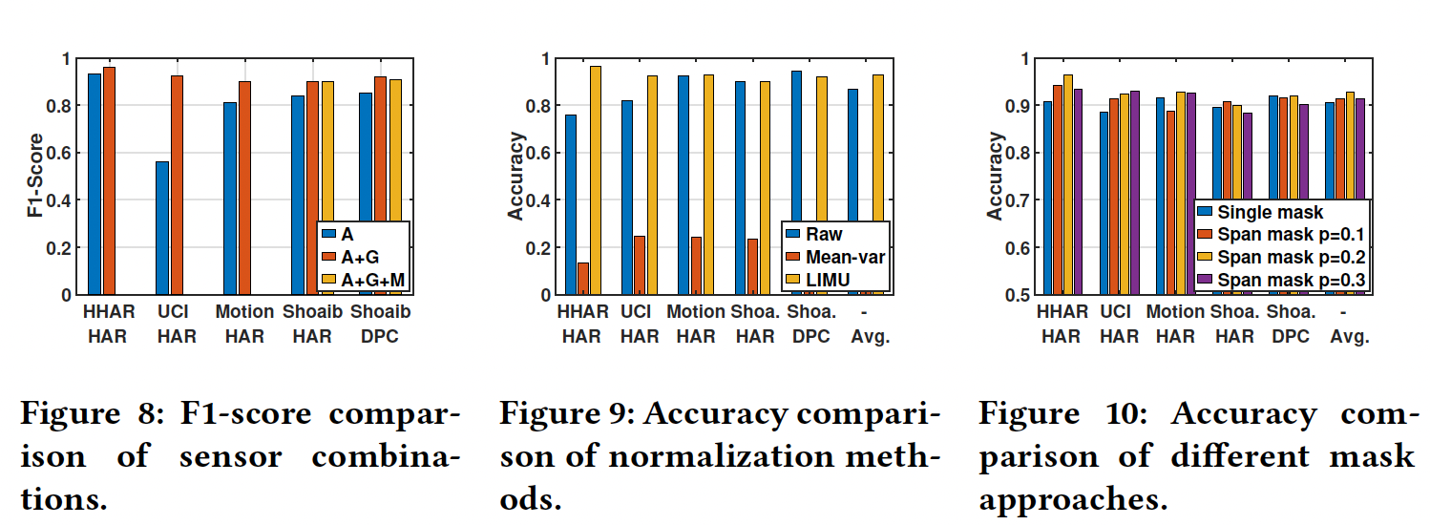

Slide 15
